Slide 1

ECREAM CONSORTIUM · F2F MEETING · KOŠICE 2026
REGULATORY STRATEGY & MEDICAL DEVICE COMPLIANCE
The EHR Certification Process
Alessandro Bacchiega · DHILab · FBK
Notes:
Good morning everyone, and thank you.
For the next twenty minutes I want to talk about the regulatory work running in parallel with our technical development, because it determines whether eCREAM can move from a project to a tool used in care. That work is certification.
I will start with what it means to certify an EHR as medical device software, and present the rules behind it.
Then I will explain the choices and the methodology we followed for the EHR platform.
I will finish with where the work stands today and what comes next.

Slide 2


Regulatory Definition
Software as a Medical Device (SaMD)
Medical Purpose Mandate
Intended Use Governs Scope
Software that serves a medical purpose on its own: supporting diagnosis, prediction, prognosis, or direct clinical treatment decisions.
The exact same codebase is classified as a medical device or non-device depending on its explicit claims, not its underlying tech stack.
Key Takeaway: Functional claims determine regulatory burden under EU Law.
MDCG 2019-11 Guidance
Notes:
To ground our discussion, we first need to define Software as a Medical Device, or SaMD. By definition, this is software that serves a medical purpose entirely on its own—supporting diagnostic, predictive, or treatment decisions.
A crucial point here is that intended use is what decides its status. The underlying technology doesn't make it a device; what matters is what the software claims to do and how it is marketed to clinicians.
Now that we know what we are talking about, let us move to the juridical framework that governs it.

Slide 3
Framework Compliance
Legal Basis & Harmonised Standards
EU MDR 2017/745 (In force May 2021)
Directly binding across all EU member states. Certification requires structured documented evidence of safety and performance compliance.
ISO 14971
IEC 62304
IEC 62366
Risk Management
Software Lifecycle
Usability Engineering
Identification of clinical hazards, risk estimation, and control verification.
Rigorous design, architecture, unit testing, and configuration management.
Ensuring clinician workflows prevent use errors and guarantee safe operation.
Key Guidance: MDCG 2019-11 (Software Qualification & Classification)
Notified Body Audit Required (Class IIa+)
Notes:
Our legal framework is anchored in the European Medical Device Regulation (MDR) 2017/745, which has been fully in force and directly binding across the EU since May 2021.
Certifying under this regulation is not just about paperwork; it requires proving strict compliance through documented evidence. This spans safety and performance requirements, risk classification under Rule 11, robust technical documentation, a formal conformity assessment with a notified body for Class IIa software and above, and ongoing post-market surveillance.
To demonstrate compliance with the MDR, we rely on established harmonized standards.
We follow ISO 14971 for comprehensive risk management—identifying what can go wrong and defining our controls.
We adhere to IEC 62304 for the software lifecycle, governing how the code is designed, built, and tested.
Additionally, IEC 62366 ensures usability so that clinicians can interact with the system safely, supplemented by the MDCG 2019-11 guidance.

Slide 4
Annex VIII · Rule 11
Software Risk Classification
Class | Software Output Role | Clinical Example
Class I | General medical software with no direct input to clinical decisions. | Display or retrieval of patient records only.
 | Provides information used to make diagnostic or therapeutic decisions. | Suggests likely diagnosis or triage priority code for clinician review.
Class IIb | Decisions where errors cause serious harm/surgery; vital parameter monitoring. | Dose calculations for high-risk therapeutic drugs.
Class III | Decisions where errors could cause death or irreversible harm. | Automated therapy decisions in critical care.
Class IIa ⭐️
eCREAM Target: From Class IIa upwards, independent Notified Body assessment of technical documentation is mandatory.
Notes:
Under Rule 11 of the MDR, software is categorized into risk classes based on its output and clinical impact.
Class I software simply displays data with no input to clinical decisions.
Class IIa—which is where our certified module sits—provides information for diagnostic or therapeutic decisions, such as suggesting a likely diagnosis for clinician review.
Classes IIb and III step up into higher-risk territories like dose calculations for high-risk drugs or automated therapy decisions.
Class III is for decisions where an error could cause death or irreversible harm.
Naturally, the higher the class, the stricter the scrutiny, requiring independent assessment by a notified body from Class IIa upwards

Slide 5
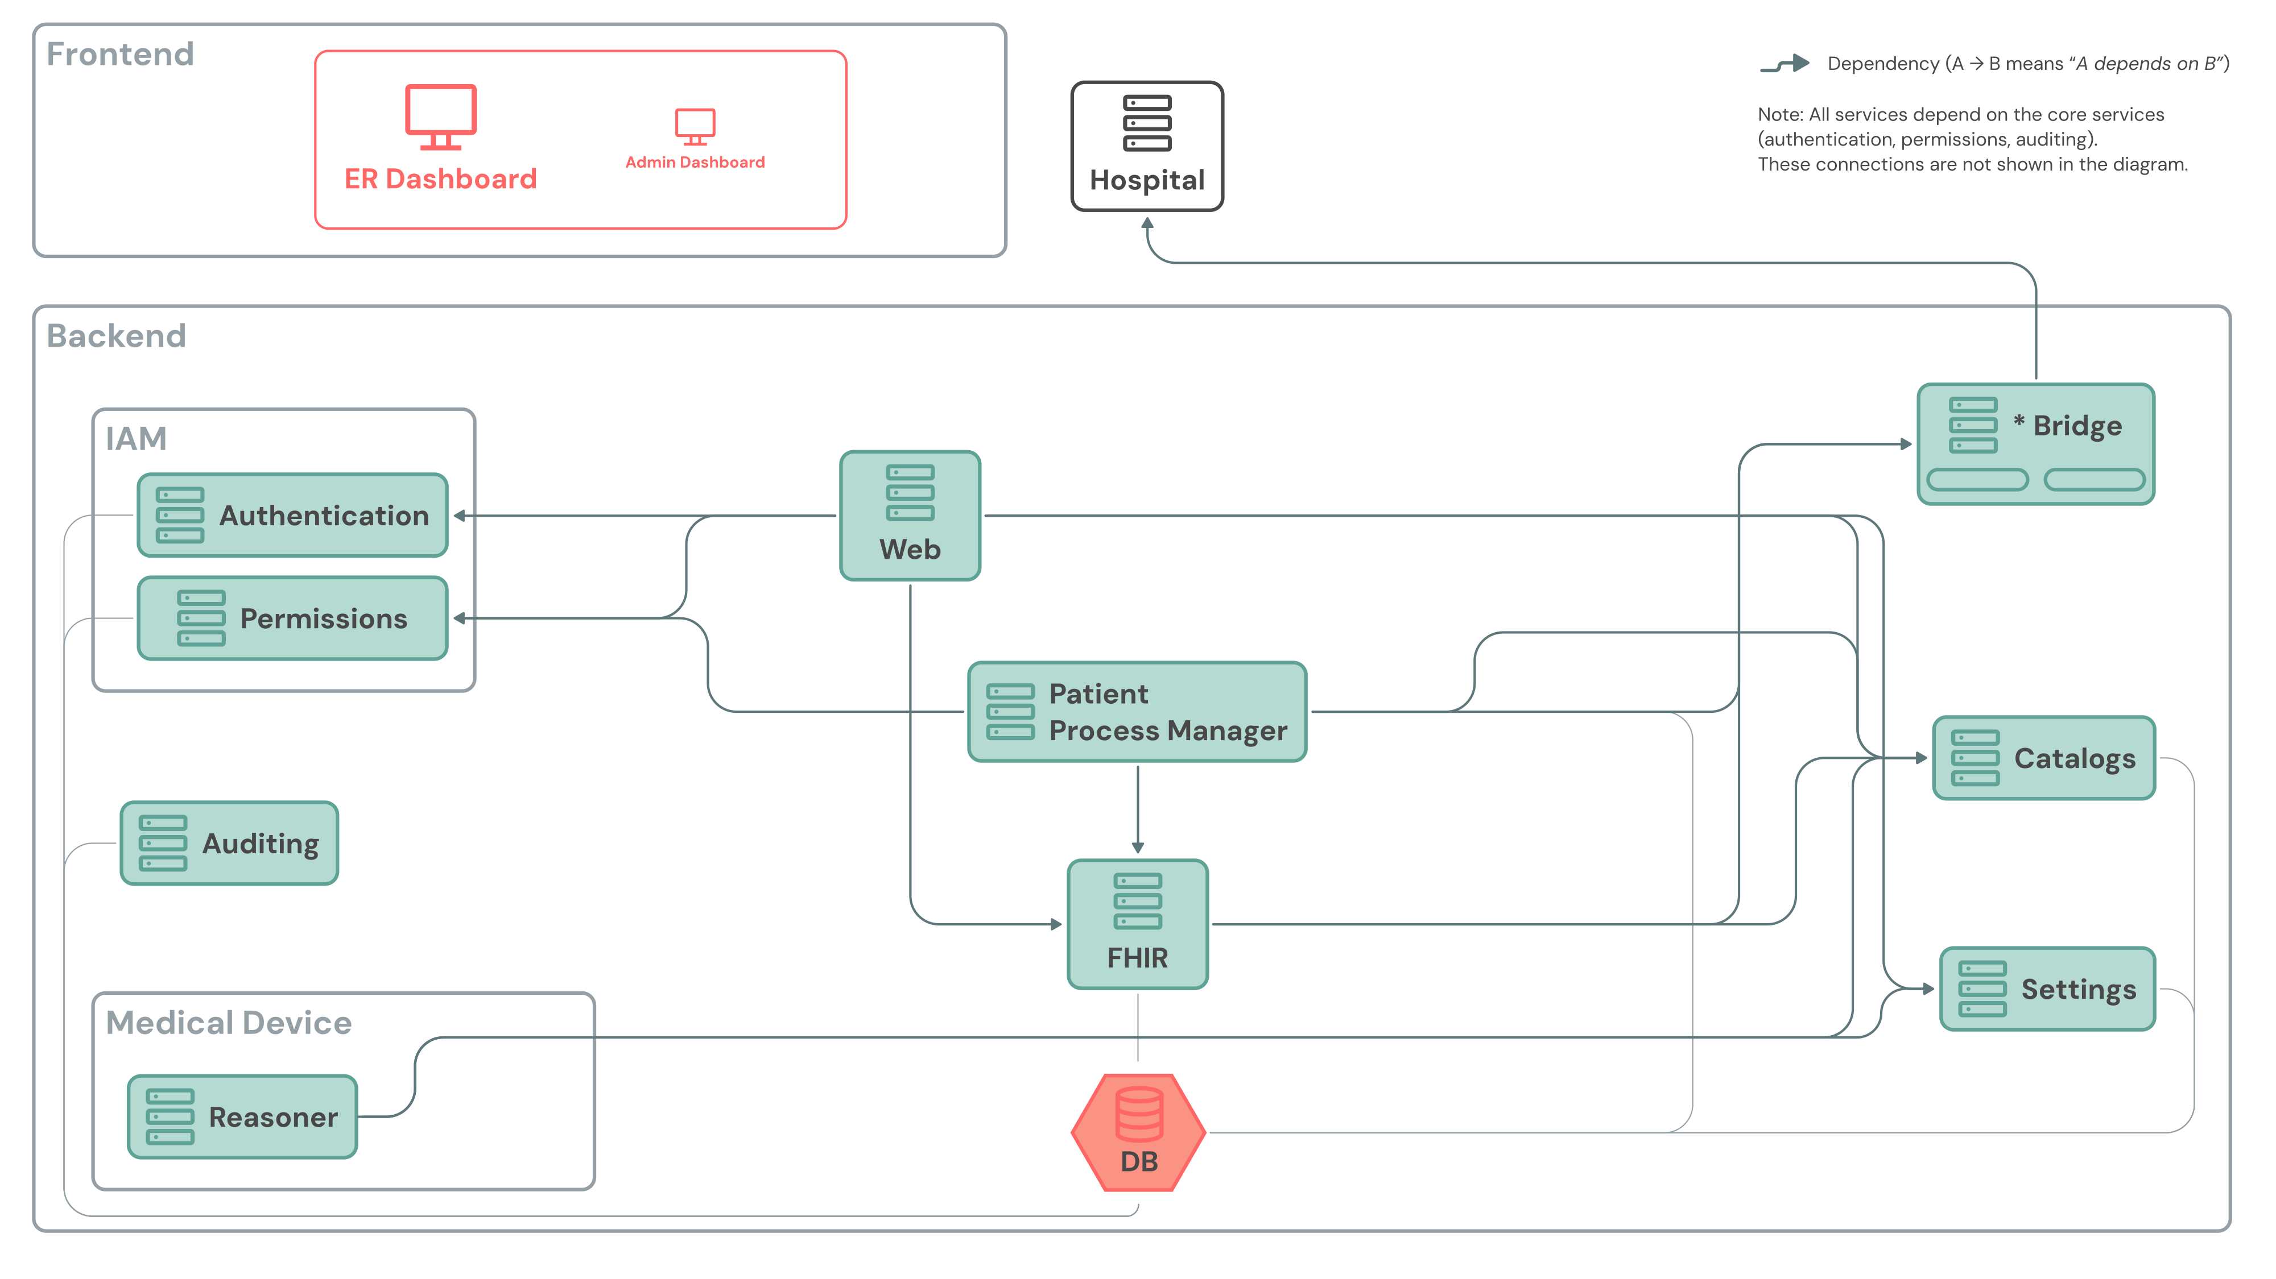
System Architecture
Why Certify Only One Module?
1. Monolith Divided into Services
Platform contains non-device components: Dashboards, Auth, FHIR data, Bridge, and Catalogs.
2. Isolation of Medical Scope
Every operation covered by the MDR is aggregated into one service: The Reasoner.
3. Focused Compliance
Certifying only the Reasoner significantly reduces audit overhead while keeping full compliance.
Documented Interfaces: Core Services, Catalogs, and Settings
SaMD Boundary Clearly Defined
Notes:
Now to eCREAM. This is a simplified view of the platform architecture. eCREAM is a monolith, but a monolith divided into modules: a frontend with the ER dashboard and the admin dashboard, and a backend with core services for authentication, permissions and auditing, and the services that handle the patient process, FHIR data storage, catalogs, settings and the bridge to the hospital.
When we started thinking about certification, we asked ourselves: do we certify the whole platform, or only what needs to be certified? The architecture gave us the answer. We decided to aggregate every operation that falls under the MDR in a single module, which we called the Reasoner. So we did not choose what to certify after the fact: we designed the platform so that what must be certified is in one place.
The consequence is that we certify this service only, and not the whole platform. The scope is smaller, so documentation, cost and risk are smaller. And the boundary is clear: everybody knows what is inside the certification and what is not. There is a price, of course. The Reasoner is not isolated from the rest: it depends on the core services, and on Catalogs and Settings. These interfaces must be described precisely, and we must keep the boundary under control over time. But we believe this is the right balance between regulatory effort and the value for the project.

Slide 6



Module Scope
What the Reasoner Service Does
PLANNED
Triage Priority
Risk Scores
Draft Clinical Notes
Allergy Check
Suggests priority code based on vitals, main complaint, AVPU, and pain scale.
Calculates validated scores: NEWS2 (deterioration), HEART, RACE, and ROSIER.
LLM-assisted draft creation for diary entries and ISBAR handover summaries.
Checks prescriptions against patient allergies & external pharma DBs.
Stateless Design: The Reasoner stores no data; clinician must explicitly confirm every output.
Human-in-the-Loop Safeguard
Notes:
Let us look at what the Reasoner actually does, because this is what we are certifying.
It has four tasks.
First, it suggests the triage priority code. It receives the data entered at triage: vital parameters, main complaint, AVPU, pain scale, care complexity. And it proposes a priority code.
Second, it calculates validated clinical risk scores: NEWS2 for clinical deterioration, HEART for cardiac event risk, RACE for stroke severity and ROSIER for stroke recognition.
Third, it drafts clinical notes using a large language model: clinical diary entries and ISBAR handover summaries. They are drafts, and the clinician reviews them.
Fourth, when a physician prescribes a medication, it checks it against the recorded allergies, using an external pharmacological database, and shows a warning that must be acknowledged before the prescription is confirmed.
Two design principles apply to all of them. The Reasoner is stateless: it does not store anything, and the results are returned to the platform. And the clinician decides: a suggestion is always confirmed by the triage nurse or physician before it is stored. This is why a wrong suggestion does not directly corrupt the clinical record, and it is an important point for the risk analysis.

Slide 7


Regulatory Risk Governance
Managing AI & Generative Software Risks
ISO 14971 Hazards
Mitigation Controls
Hallucination Risk: Fabrication of clinical details in draft notes.
Draft Only Mode: LLM output is strictly marked as editable draft.
Non-Determinism: Varied draft outputs for identical inputs.
Mandatory Action: Explicit clinician edit/confirm button required.
Automation Bias: Clinicians accepting draft text without review.
Prompt Bounds: Context-locked prompting & validation datasets.
Audit Strategy: Standardizing prompt pipelines under IEC 62304 configuration management guarantees test repeatability.

Slide 8
Execution Strategy
Methodology & Specialized Guidance
EXTERNAL PARTNER
INTERNAL CONSORTIUM
MAYTAL Global
DHILab / FBK Team
Global medical device regulatory expertise
Technical software architecture & design
Document structure & template alignment
Risk identification & clinical controls
Ongoing review against harmonized standards
Implementation, unit testing & verification
Collaborative governance ensures both technical rigor and regulatory compliance.
Notes:
Navigating this regulatory landscape successfully requires specialized expertise.
Our team at DHILab handles all the technical content—requirements, design, risk analysis, implementation, and testing. We partner with MAYTAL, a specialized regulatory consultancy that provides template structures, document frameworks, and rigorous reviews against international standards.
In practice it is a loop: we write, they review, we correct. This matters for two reasons. It reduces the risk of discovering problems late, and it makes sure our documents are written the way an auditor expects

Slide 9
Technical Documentation
Design & Risk Documentation Stack
SAD · IEC 62304
Software Architecture Design
DONE
High-level organization, main parts (Items/Units), third-party software, and component interaction.
SDD · IEC 62304
Software Detailed Design
DONE
Detailed logic per Unit: inputs, outputs, data structures, and safety/security classification.
RAT · ISO 14971
Risk Analysis Table
ONGOING
Hazards, pre/post risk estimation, and safety controls. Links clinical hazards to code requirements.
The Risk Analysis Table serves as the primary bridge where clinical needs meet software engineering.
Notes:
Here we have two design documents and the risk analysis.
- The Software Architecture Design describes how the software is organised: its main parts, which we call Items and Units, the third-party software we rely on, and how the parts interact. It is done.
- The Software Detailed Design goes one level deeper: for each Unit, what goes in, what comes out, and whether it matters for safety and for security. It is done as well.
- The Risk Analysis Table lists what can go wrong, how serious it would be, and which controls we put in place. It has had a first review by the certification company, and we are now updating it according to their feedback. One point I want to stress, especially for the clinicians. The Risk Analysis is where the clinical and the technical worlds meet. A hazard you would recognise from practice, for example a wrong or missing result in an emergency setting, becomes a requirement for the software and later a test.

Slide 10
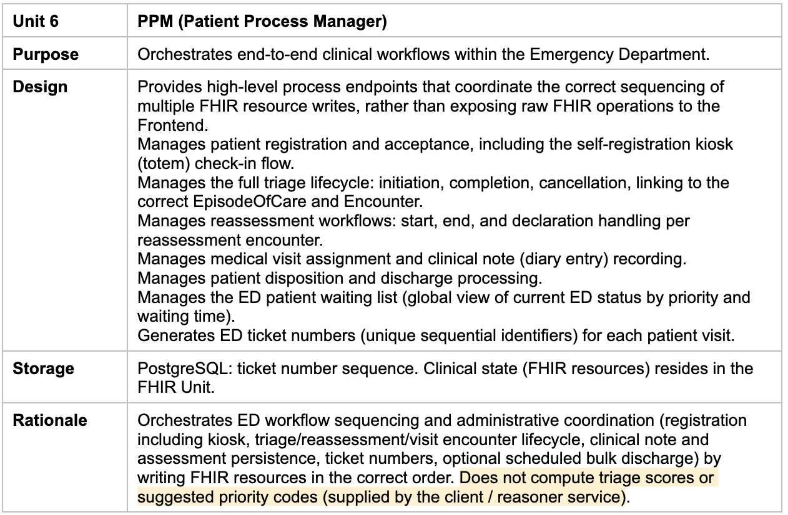
Execution Strategy
Software Architecture Design: an example

Slide 11
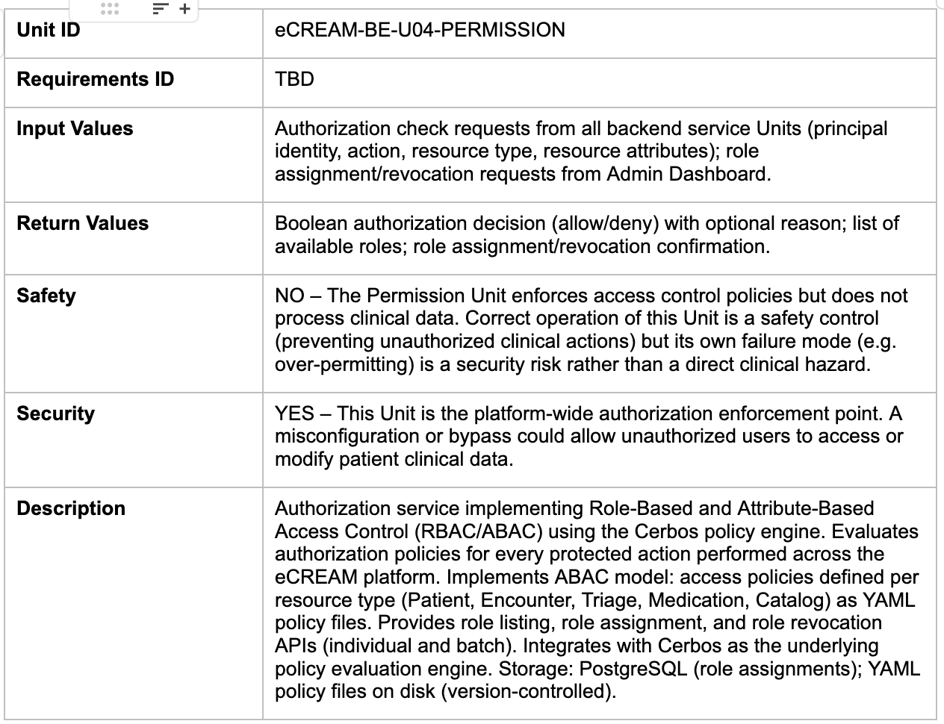
Execution Strategy
Software Detailed Design: an example

Slide 12

Traceability Cascade
Requirements Derivation (SYSR → SRS)
SYSTEM REQUIREMENTS (SYSR)
SOFTWARE REQUIREMENTS (SRS)
High-Level User & System Needs
Testable Software Specifications
SYSR-027: Before a triage assessment completes, the operator shall be able to accept the proposed priority code or assign a different code manually.
SRS-027.01: Upon triage confirmation, the system shall display a popup presenting the Reasoner-suggested priority code and require the triage nurse to explicitly confirm or modify it.
In Progress
In Progress
Bi-directional Traceability: Any change in SYSR must immediately update SRS and test artifacts.
Notes:
Our requirements engineering follows a strict two-tier traceability model. We define System Requirements (SYSR) capturing what the overall system must do to satisfy user and clinical needs. These derive directly into precise, testable Software Requirements (SRS).
The System Requirements and the Software Requirements are in progress as well, and the two are being written side by side. They are related because every software requirement derives from a system requirement, and we must be able to trace it back.
Let me give you a pair from the triage function. At system level, the requirement says that before the triage is completed, the operator must be able to accept the proposed priority code or assign a different one. Going down to the software level, the corresponding requirement says that at confirmation the system shows a popup with the priority code suggested by the Reasoner, and requires the triage nurse to explicitly confirm or modify it. It is the same principle at two levels of detail: the software suggests, the clinician decides. The second statement can be verified with a test, and the first one is the reason why it exists. This is why the two documents move together: if a system requirement changes, the software requirements must follow, and the other way round. It is also the basis for what comes next, because the test plan will verify these requirements one by one.

Slide 13
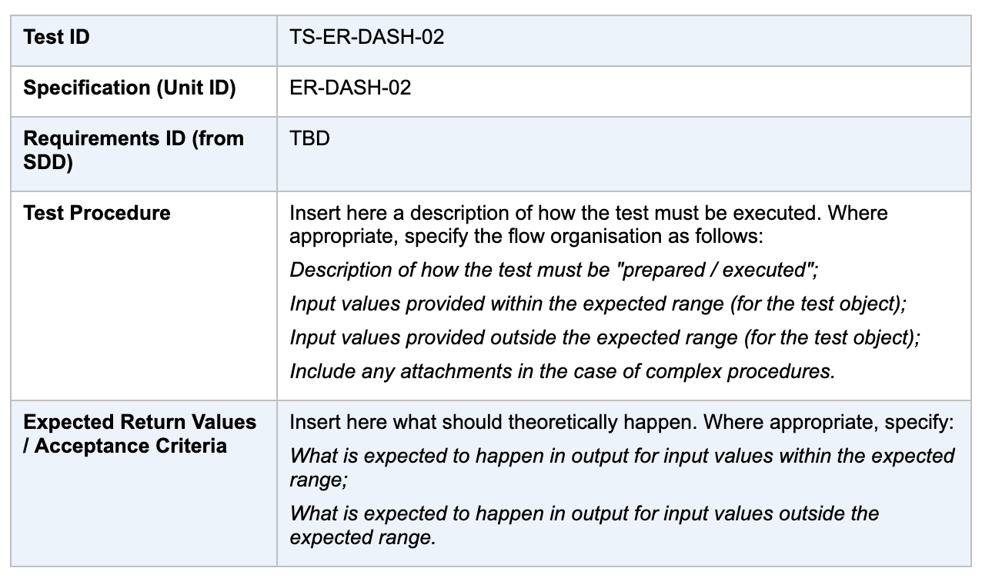
Execution Strategy
Testing & Verification: an example

Slide 14

Execution Roadmap
Certification Milestones & Status
2
3
4
Phase 1
Phase 2
Phase 3
Phase 4
Architecture (SAD, SDD)
Requirements & RAT
Verification Protocols
Notified Body Submission
COMPLETED
IN PROGRESS
UPCOMING
TARGET 2026/27
Next Steps: Finalize SRS derivation and prepare software tracking tables linking requirements to test cases.

Slide 15


Next Steps & Closing
Proving It Works: Testing & Verification
Test Plan
Software Tracking Table
Defines how each requirement will be systematically verified, along with clear acceptance pass/fail criteria.
Bi-directionally links every requirement to its associated risk, design element, and verification test case.
Alessandro Bacchiega · DHILab · FBK
Thank You / Questions & Answers
Notes:
What comes next is about proving that the Reasoner does what we say it does. There are two documents. The Test Plan defines how each requirement will be verified, and what counts as a pass. The Software Tracking Table is what regulators call traceability. In one sentence: it links every requirement to its risk, to the design element that implements it, and to the test that verifies it. The result is that nothing exists without a reason, and nothing is left untested. If an auditor asks why a function exists, we follow the line back to a requirement and a risk. If they ask how we know it works, we follow it forward to a test. That is where we are heading.

